Slide 1

NACL
201
Presentation by:
S.Suresh
CloudSIKSHA

Slide 2
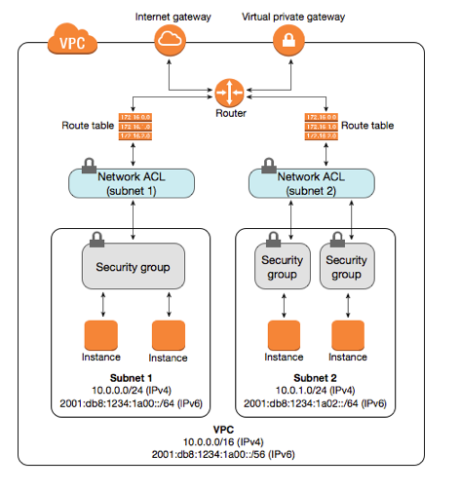
Network Access Control List

Slide 3
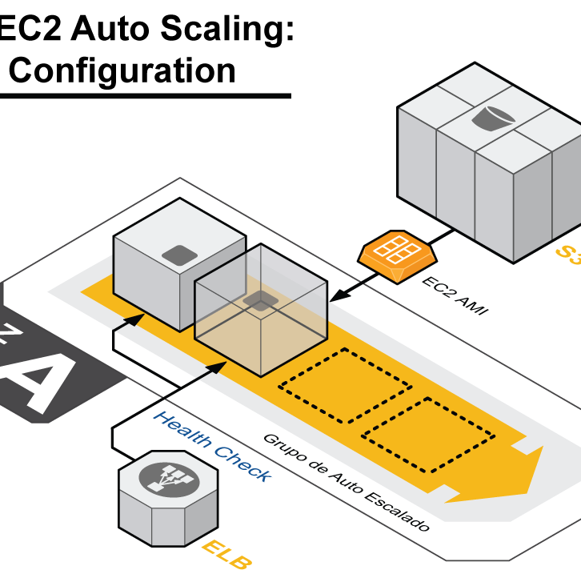
Network ACL
Acts as a firewall
Controls traffic in and out of subnets
Default Network ACL created when VPC is created
  Attached to all subnets initially
  Allows all traffic to flow in both directions

Slide 4

Custom NACL
Custom NACL can be attached to any subnet
  Default custom NACL will block all traffic
  Need to put in rules to allow traffic
Each subnet will be associated with one NACL
  If no custom NACL specified will be associated with default NACL
One subnet one NACL
  One NACL can be associated with multiple subnets

Slide 5

NACL Rules
Each rule has a number
Evaluated from lowest number to highest
  32766 is the highest number that can be used
Evaluation stops when a rule is satisfied
  Need to careful when writing rules else there could unintended consequences
Inbound and Outbound rules
NACL is stateless

Slide 6
NACL Inbound Rules
Inbound Rules
Rule # | Type | Protocol | Port Range | Source | Allow/Deny | Comments
100 | HTTP | TCP | 80 | 0.0.0.0/0 | Allow | Allow all traffic to this subnet
200 | MySQL | TCP | 3306 | 10.0.1.0/24 | Deny | Deny traffic from 10.0.1.0/24 subnet
300 | MySQL | TCP | 3306 | 0.0.0.0/0 | Allow | Allow MySQL traffic
400 | SSH | TCP | 22 | 10.0.2.0/24 | Deny | Explicitly Deny SSH traffic from 10.0.2.0/24 subnet
500 | SSH | TCP | 22 | 0.0.0.0/0 | Allow | Allow all SSH traffic
* | All Traffic | All | All | 0.0.0.0/0 | Deny | Default rule present in all NACL

Slide 7
NACL Outbound Rules
Outbound Rules
Rule # | Type | Protocol | Port Range | Destination | Allow/Deny | Comments
100 | Custom TCP | TCP | 1024-65535 | 0.0.0.0/0 | Allow | Open all higher ports for response
200 | SSH | TCP | 22 | 10.0.1.0/24 | Allow | Allow SSH to 10.0.1.0/24 subnet
300 | RDP | TCP | 3389 | 10.0.1.0/24 | Deny | Explicitly deny all RDP traffic to 10.0.1.0/24 subnet
400 | RDP | TCP | 3389 | 0.0.0.0/0 | Allow | Allow all RDP traffic
* | All Traffic | All | All | 0.0.0.0/0 | Deny | Default rule present in all NACL

Slide 8
NACL vs Security Groups
Security Group | NACL
Instance Level security | Subnet Level Security
Stateful (Understands difference between request and response) | Stateless (Inbound and Outbound rules must be specified)
All rules are evaluated | Evaluated from smallest rule number. Evaluation stopped when condition is matched
Permissive (Only Allow rules) | Allow and Deny rules
More than one security group can be attached to an instance | Only one NACL per subnet

Slide 9

Thank you

